Slide 1


Heritage Identification Of Monuments using Deep Learning Techniques
KIET Group of Institutions, Ghaziabad
(Certified & ‘A+’ Grade accredited Institution by NAAC)
Guide Name: Dr. Rishabh
1. Shivam Kumar (2100290120156)
2. Vipin Chauhan(2100290120191)
3. Ujjwal Sharma(2100290120178)
4. Sukriti (2100290120166)

Slide 2
Problem Statement
TO IDENTIFY THE MONUMENTS FROM DYNAMIC IMAGES USING DEEP LEARNING AND INTEGRATION OF INTERPRETABILITY FOR THE PREDICTED OUTCOMES.

Slide 3
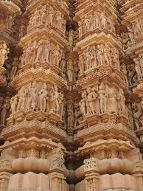
Objectives
Automate Heritage Identification: Develop a deep learning model capable of automatically identifying and classifying monuments and heritage sites from images.
Enhance Accuracy: Improve the accuracy and reliability of heritage site recognition by training the model on diverse and extensive datasets.
Facilitate Preservation Efforts: Support historians, archaeologists, and conservationists in preserving cultural heritage by providing a tool that quickly and accurately identifies at-risk sites.
Create a User-Friendly Interface: Implement a user-friendly interface using Streamlit to make the technology accessible to non-experts, allowing for broader use in heritage conservation.
Promote Digital Documentation: Contribute to the digital archiving of cultural heritage by enabling the creation of detailed and accurate records of identified sites.
Minimize Manual Effort: Reduce the manual effort required in heritage identification, freeing up resources for other preservation activities.
Encourage Public Engagement: Increase public awareness and engagement in cultural heritage preservation by providing accessible tools and information.

Slide 4
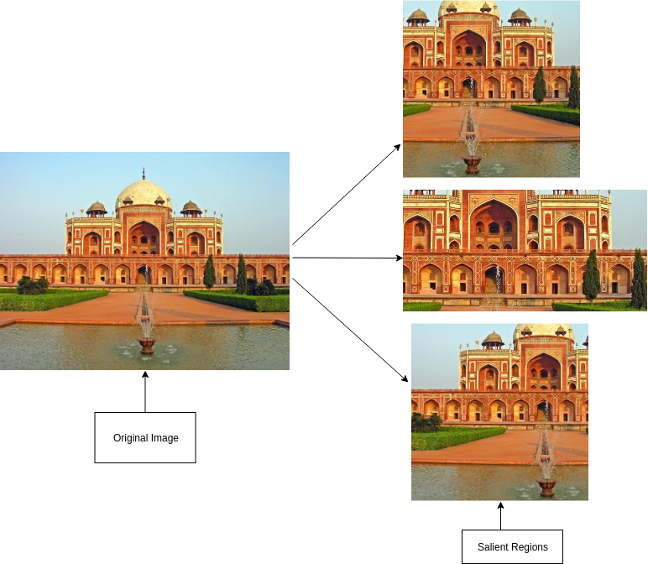
Technology Used
Python
TensorFlow
Python libraries: OpenCV, matplotlib, GeoPy
CNN
Kaggle Dataset
Streamlit
LabelImg

Slide 5
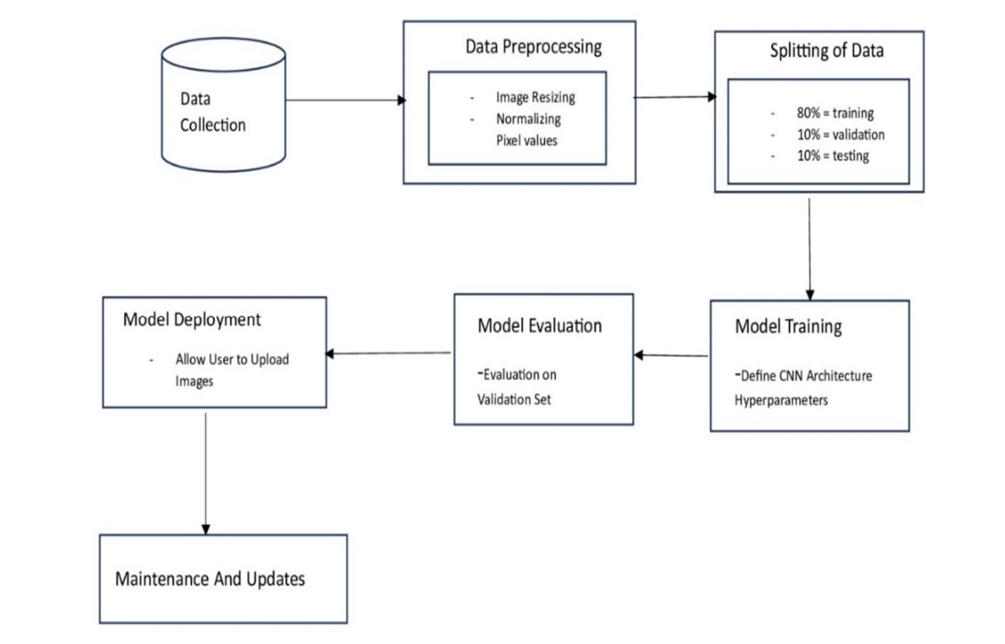
Workflow Diagram

Slide 6
Methodology
Data Collection Collected images of various Indian heritage monuments from open datasets and online sources.
Data Annotation Labeled images using LabelImg to mark regions of interest and assign class labels to each monument.
Preprocessing Resized and normalized images to ensure consistency for model training.
Model Development Trained a Convolutional Neural Network (CNN) using TensorFlow/Keras to classify the monuments based
on image features.
Model Optimization Applied transfer learning and tuning techniques to improve accuracy and reduce computational load.
Interface Development Built a Streamlit web application that allows users to upload images and get real-time monument identification.
Deployment (Local) Integrated the trained model into the Streamlit app for seamless offline/localhost use.

Slide 7
Literature Survey
Title: "Deep Learning for Classification and Restoration of Historical Photographs"
Authors: A. Gebru, D. Gordon, M. Li, L. Carin
Title: "Heritage Image Classification Using Convolutional Neural Networks"
Authors: A. Ali, M. M. Hussain, M. H. A. Khan, S. A. Madani

Slide 8
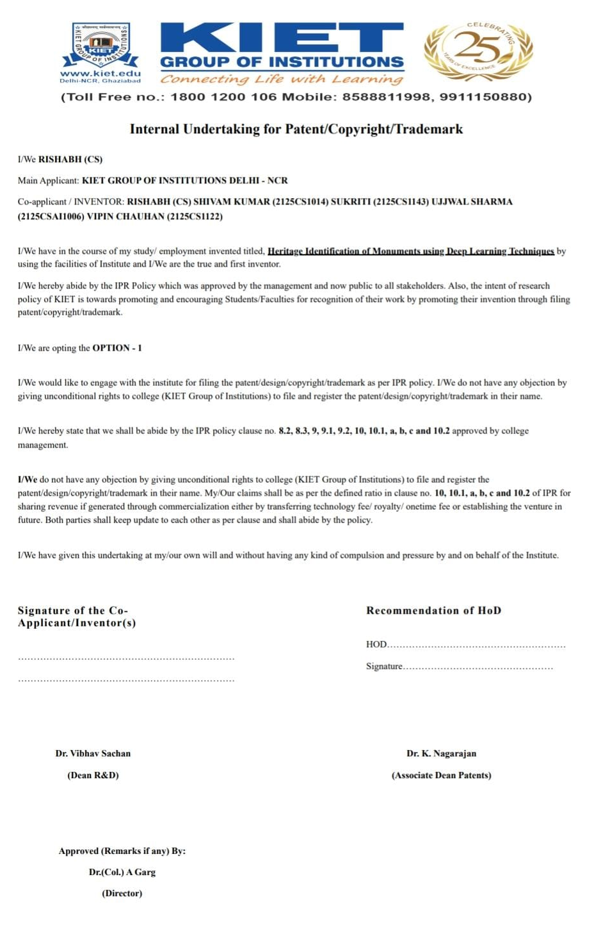
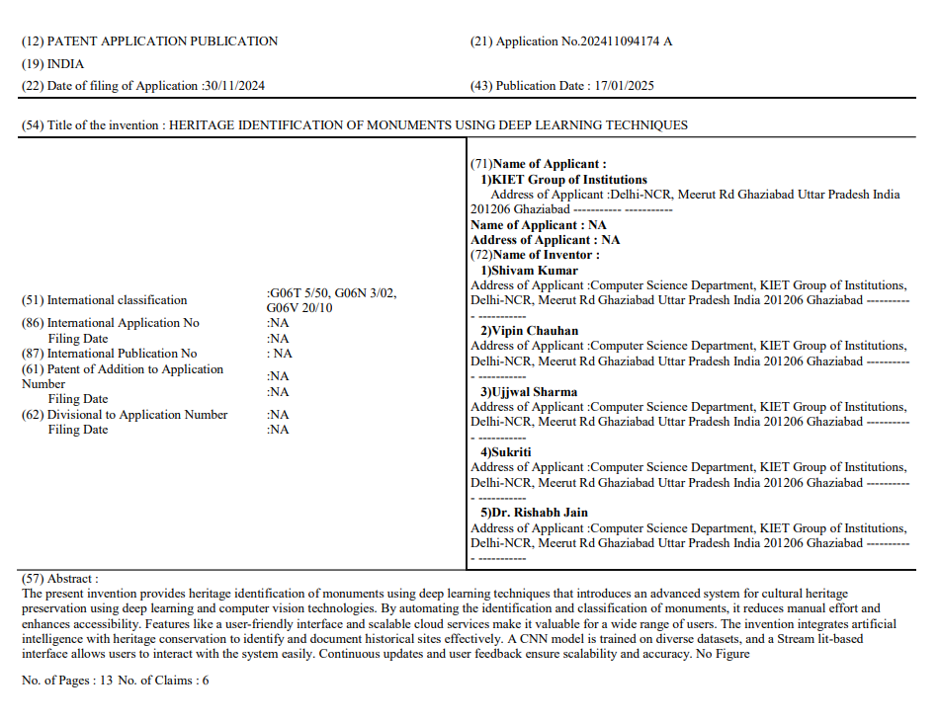
Patent Status
Published

Slide 9
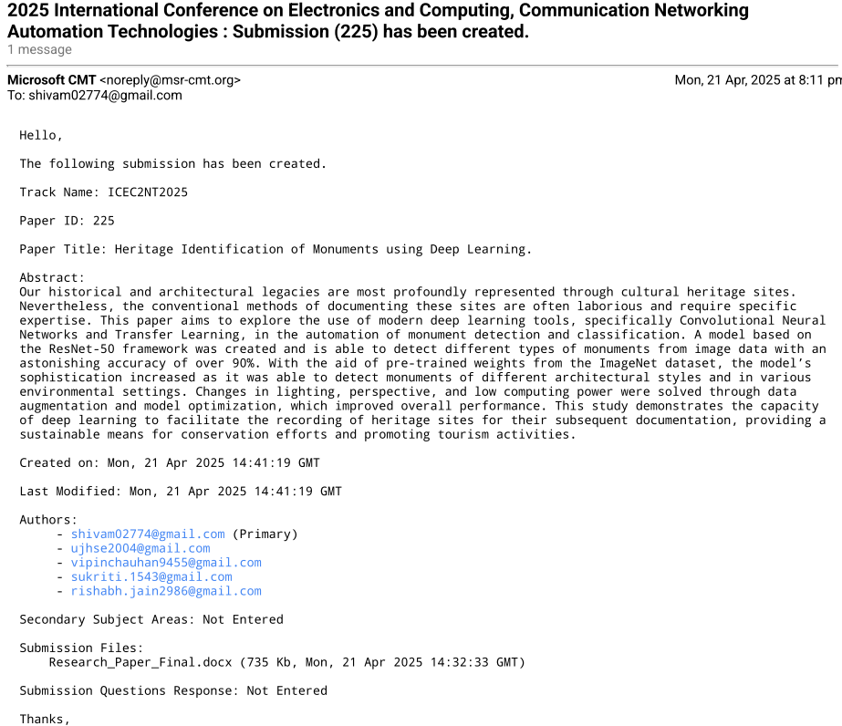
Research Paper Status
Submitted

Slide 10
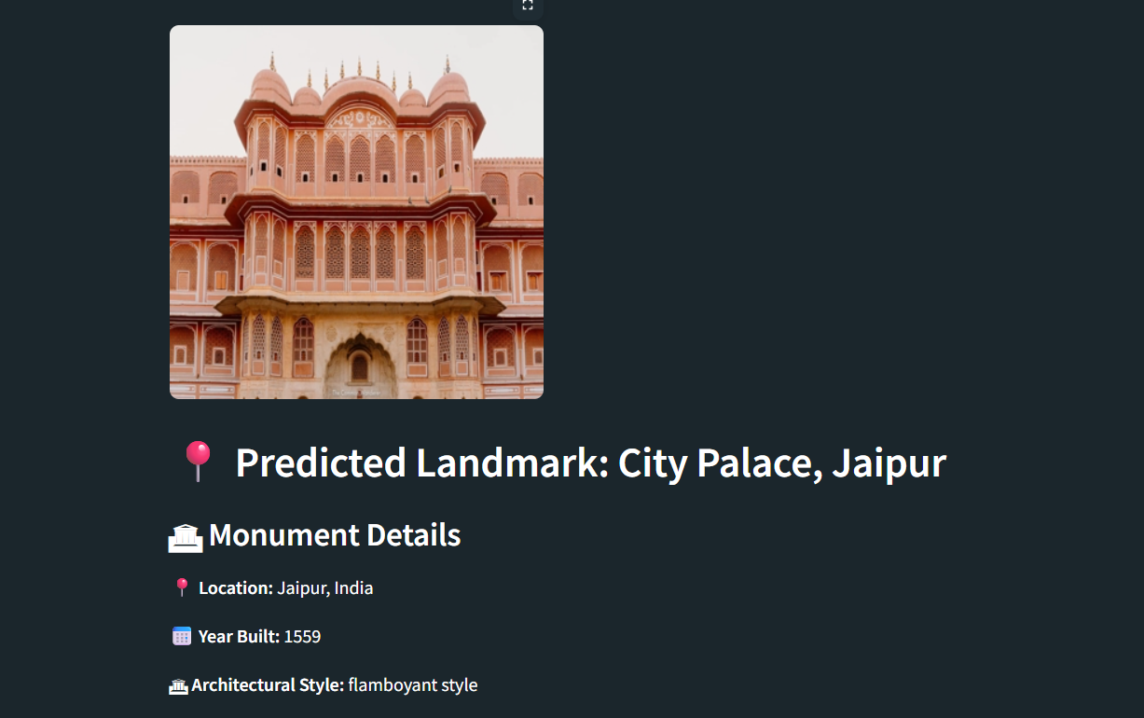
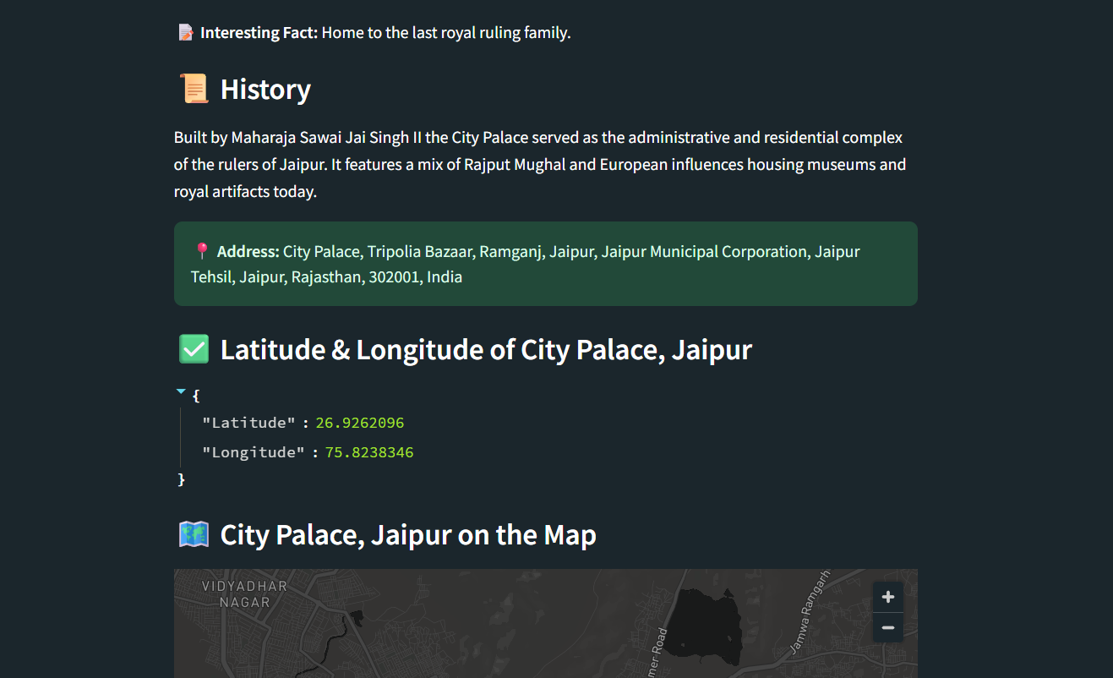
Project Status
Completed

Slide 11
References
Voulodimos, Athanasios, et al. "Deep learning for computer vision: A brief review." Computational Intelligence and Neuroscience, vol. 2018, Article ID 7068349, 13 pages, 2018.
Goh, Say Wei, et al. "Deep learning architectures for monuments identification." Proceedings of the 2019 International Conference on Computer Vision, pp. 456-465, Seoul, Korea, October 2019.
Goodfellow, Ian, Yoshua Bengio, and Aaron Courville. Deep Learning. MIT Press, 2016.

